Slide 1

“Discover England” Website Project by Codeza
Ebru Athan
Esma Zeynep Söylemez
Zehra Duran
Ada Keskin
Azra Öztürk

Slide 2
Our purpose in designing this project is to create a website for the people who might want to visit or research about England, we wanted to give them some information about destinations,rotations and some things like that. Due to the our limited knowledge about coding in Html and CSS, we were able to only create the main page of the website.
We used Visual Studio Code for coding our website and after that we uploaded on Github.

Slide 3
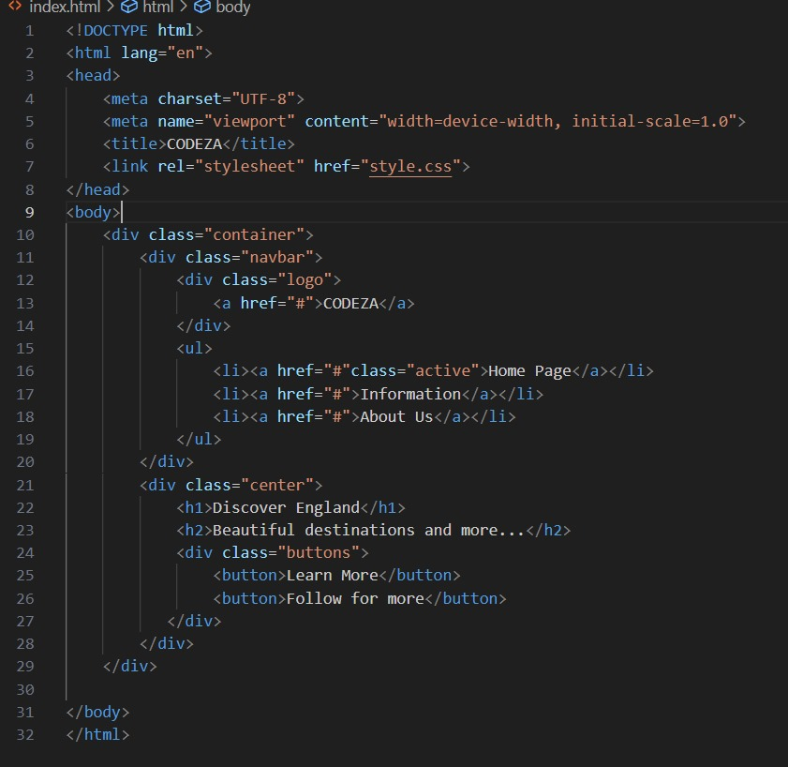
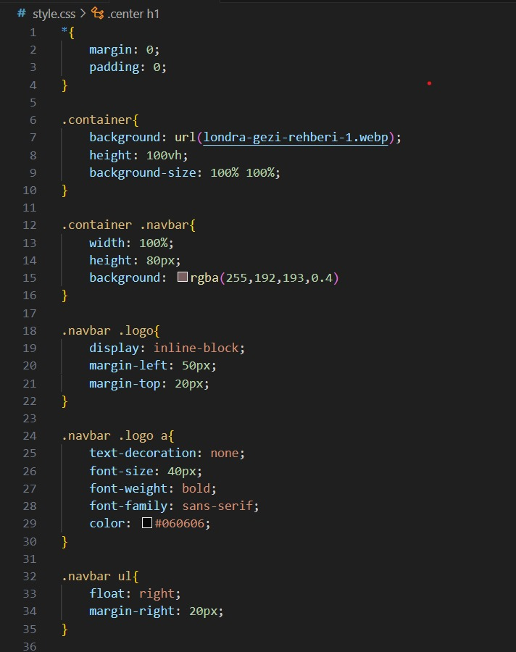
Our coding process
These are some example code parts from our project .

Slide 4
With creating this project we learned how to create a website structure and button formats and how to change them related to their color, font size some things like that. It really helped us to practice on writing our codes faster.
In this project we also use Html and CSS together.In the beginning we struggle about writing the project but after working on that code a while we solve the problems and we complete our project.

Slide 5
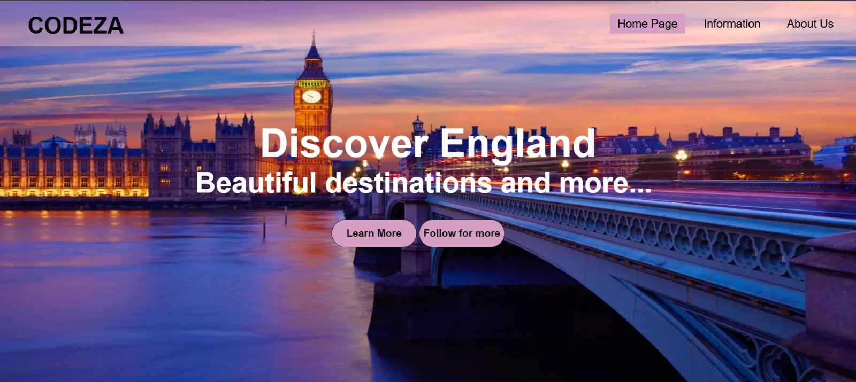
Our Discovery England Project’s final look:

Slide 6
Thank you for listening to us…

